Slide 1
Praying 201…squirrel!
January
2022
RIM, ARRR AND DISTRACTIONS

Slide 2
Relationship Identity Mission (RIM)
3 Legged stool, can’t have one without the others

Slide 3
Relationship
Who am I?
In short nothing compared to God
Creature merely
Dust- in the image and likeness of God

Slide 4

Kerygma

Slide 5
Identity
God’s Beloved Sinner
Beloved Son or Daughter of God
God is my Father
God is my friend
God is my Creator and Redeemer
Whose am I?

Slide 6
Mission
How am I to act towards God, myself and others?
Towards God
Towards myself and others
Reverence
Utter confidence in His Designs and Plan
Gratitude
Faith, Hope and Love
Follow His Will not mine
Faithful not successful
“Love your neighbor, as yourself”
Being loved yourself, sharing that with others constantly
Sharing the Love God has for the stranger, personally
Pay close attention to the One who is always loving me into existence , every moment

Slide 7
Pray like a Pirate
Acknowledge- what is actually going on with us
Relate- Talk to God about it – as boldly as we can
Receive – spend that time in silence and Scripture (Lectio Divina)
Respond- do something about it, share the grace, or Colloquy
ARRR

Slide 8
Acknowledge
Being aware

Slide 9
Relate
Talk to God as the one you loves you the most

Slide 10
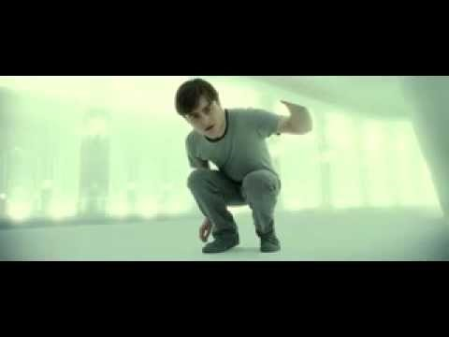
Receive
Just spend the time in silence wait for his voice
Use Scripture
Or righty a dialogue

Slide 11
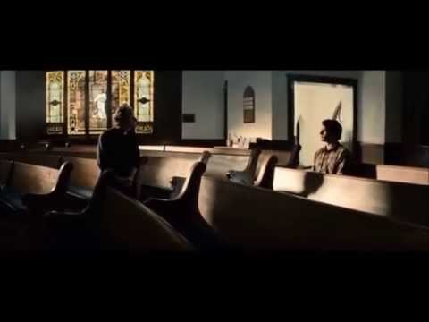
Respond
Share the Grace/ Journal it/ show the love you received in Prayer

Slide 12
What distracts us in prayer?
Tasks
Personal relationships
Sleepiness
Phone
Whatever is the next thing is

Slide 13
Why do we dislike Silence?
It’s difficult
The world is not prone to it
We are not trained in it
We are wounded?
  Father wound
  Unworthiness
  Perfectonist

Slide 14
In silence I can’t hide!
Which I am really good at I think!!
Just look at Adam and Eve
Failure
Holiness is perfection (huge strain)
Having to be the happy one vs Joyful one

Slide 15
Understanding Our Sinfulness
Sin
  fruitful sinfulness
Sinfulness-
  this is the source of the action of sin
  Is connected to attitudes
  Lie or vows that we can’t break
Pain –
  wounds may pierces the heart, this pain is the root of sinfuliness

Slide 16
Wounds- pain the pierces of the heart
  Abuse
  Divorce
  Absent father
  Humiliation
  Rejection
Lies-
  (we ask-why) about ourself, “it my fault”, about others- “my dad doesn’t love me” about the situation- “it was destine to happen”, about God’s presence, “God abandoned me”
Inner vows-
  promises we make to ourselves out of fear, lies and pain- “I never be like my… or I will not trust or be vulnerable, again”

Slide 17
What I believe influences what I do
Lie-I am not loved, no on wants or desires me, I am not good enough, I am not valued or important
Lie – If I trust I’ll be hurt, I need to protect myself or something bad will happen
Lie- I feel helpless, numb, I don’t know what to do… everything is out of control
Vow- I’ll never trust again, I’ll do it on my own, I’ll always be in control
Isolation from God
Fruit-sins of the flesh-self-righteous, judgement, bitterness resentment, depression, passive-aggressive behavior, gossip, sarcasm
Fruit- sins of the flesh- Rage, revenge, retaliation, murder, violence, malice, verbal abuse, insults, slander

Slide 18
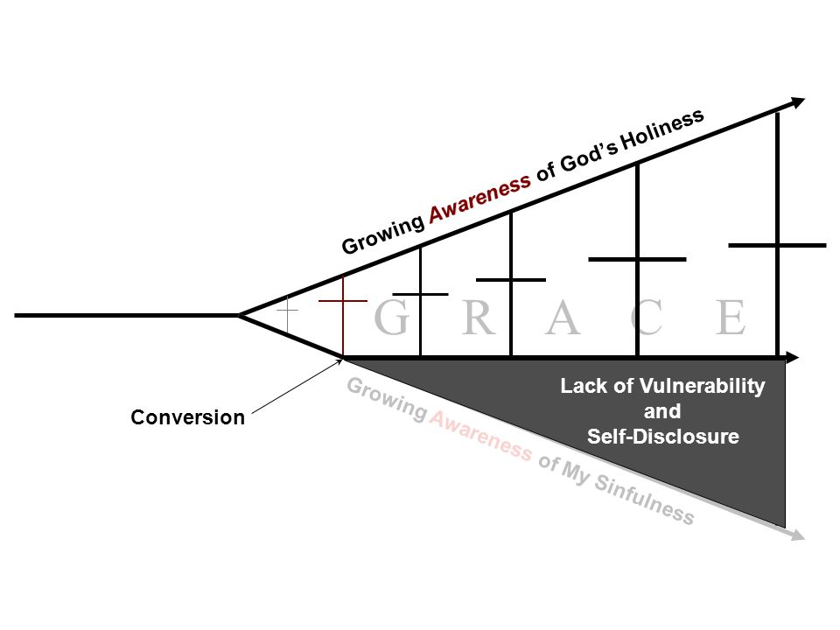

Slide 19
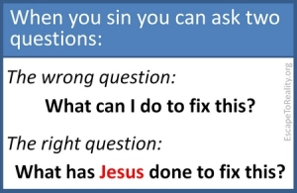

Slide 20
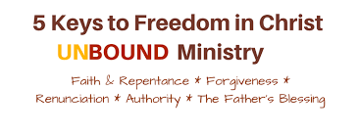
Unbound 5 keys

Slide 21
“I am the Way, The Truth and the life The Truth will set you free!!”
Ask God to reveal your patterns of sin. Ask God to reveal the attitudes, thoughts or lies feeding those patterns. Ask God to reveal the root of the attitudes. Be patient…this may bring you back to a pain-filled memory. Ask God to show you where he was in the memory. Ask God to reveal the lies you believed. Ask God to reveal the promise you made because of the lies. Ask God reveal the truth.

